Slide 1

Sleep Analysis
By: Nhia Yang
This Photo by Unknown Author is licensed under CC BY-NC-ND
Notes:
Good evening everyone! I’ve decided to conduct a sleep analysis for my project. I hope you all will enjoy my presentation!

Slide 2

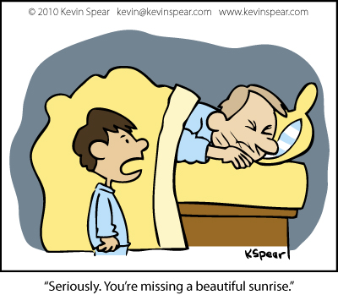
Introduction
The Mayo Clinic recommends 7hrs of sleep for adults.
Father of 3
Full-time employed
Part-time student
Do I sleep more on my days off?
Notes:
The Mayo Clinic recommends 7hrs of sleep for adults.
Click
However, as a father of 3, working fulltime in a 12hr rotating 3rd shift, and being a part-time student
Adequate sleep can be challenging; therefore, It is evident that I am not consistently getting 7hrs.
click
However, I do like to know if there any differences in my sleep times whether I am working or not.

Slide 3
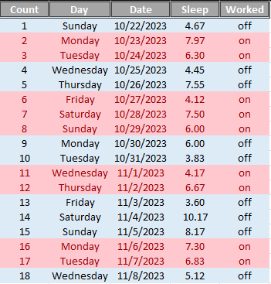
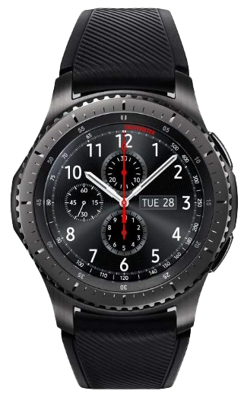

Data
18 Observations
Variables
Work Status
On – red / Off – blue
Sleep
Hours per day
Measuring Device
Samsung Fitness App – Watch
Notes:
There are 18 observations captured as you can see in the table.
Click
For the variables, I have work status and sleep hour
click
For the measuring device, I use the Samsung app and watch.

Slide 4
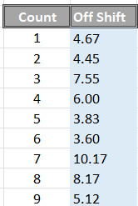
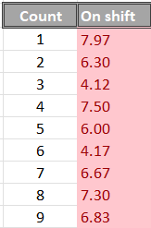
Data
Total sleep on off days
Total sleep on worked days
Notes:
Taking a deep look at the data, I’ve broken them into two separate table for easier viewing.
Click for first table
Click for second table

Slide 5
Hypothesis Testing
Claim:
The mean total of hours slept on my off days is significantly higher than the mean total of hours slept on my worked days.
Variables:
Dependent: hours of sleep
Independent: working status
Notes:
Click for claim
Click for variables

Slide 6
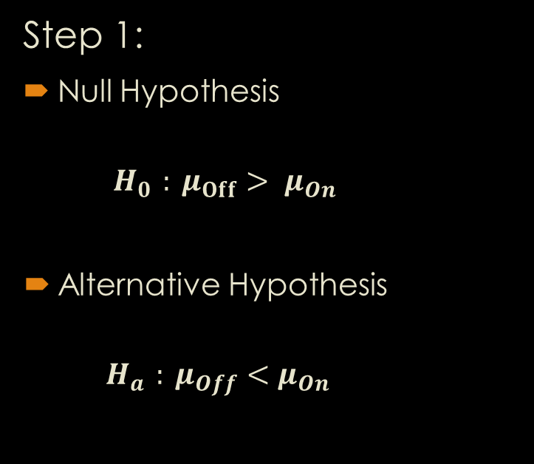
Hypothesis Testing
Step 1:
Null Hypothesis
$$H_{0 }: μ_{Off}> μ_{On}$$
Alternative Hypothesis
$$H_{a }: {μ_{Off}<μ}_{On}$$
Step 2:
Testing Method
Two sample
Paired t–test
Notes:
Null Hypothesis
Ho
(H-naught)
Alternative Hypothesis
Ha
Click for step 2

Slide 7
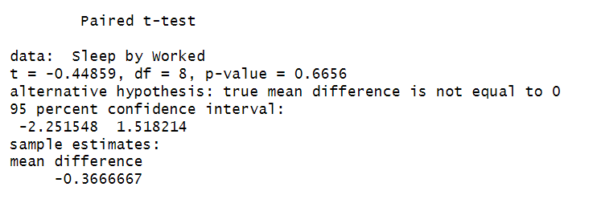
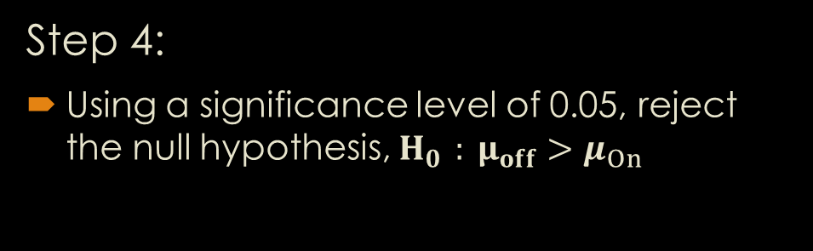
Hypothesis Testing
Step 3:
Test Statistic
T = -0.44859
P-value : 0.6656
Step 4:
Using a significance level of 0.05, reject the null hypothesis, $H_{0 }: μ_{off}>μ_{On}$
Notes:
Click for picture

Slide 8
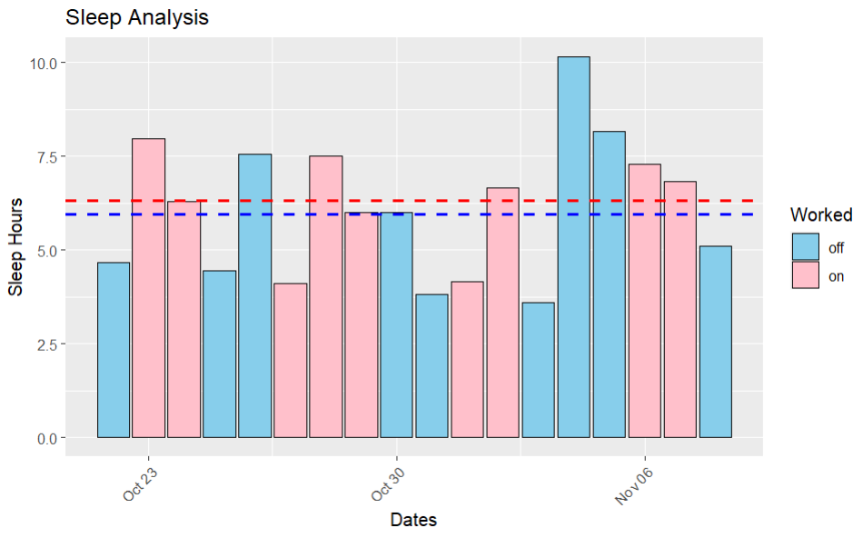
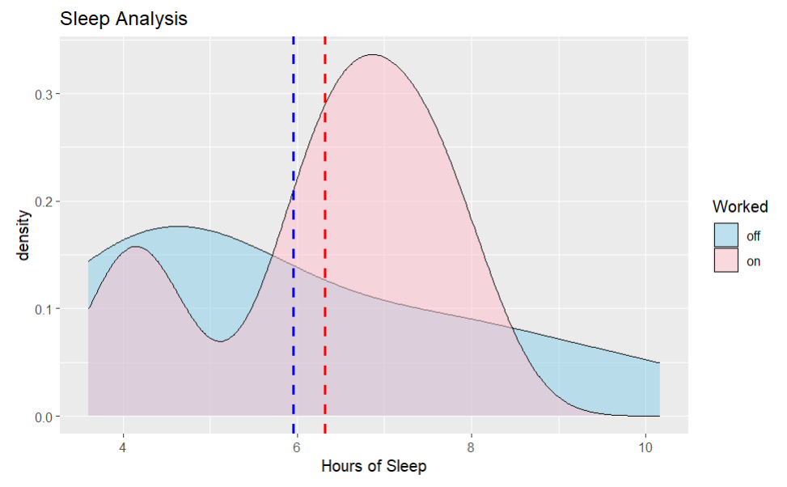
Visual Aids
Notes:
As you all can see, I have two different charts. One is a histogram filled with the working status which includes the mean lines.
Secondly, I’ve also included a density graph filled with the working status as well. And likewise, I’ve included the mean lines as well.
Density:
Off days is a right skewed
On days is a double

Slide 9
Conclusion
Since the p-value of 0.6656 is greater than 0.05, the data is not enough to conclude that the two means are not equal. Therefore, we fail to reject the null hypothesis as the result of this test.

